Slide 1
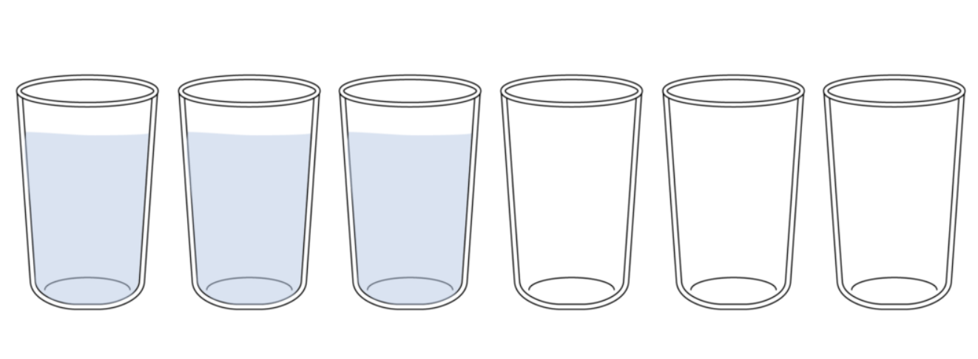
Move one glass only…
There are 6 glasses on a table , three glasses on the left that are full and three on the right that are empty.
If you make one change you will have a row of alternate full and empty glasses.

Slide 2
Interrupt

Slide 3

objectives
At the end of the lesson, students should be able to:

Slide 4
What is an Interrupt?
Interrupts are a response by the processor to a process/event that needs immediate attention from the software.
It alerts the processor and servers that a request for the CPU to interrupt the currently executing program/code when permitted, in order so that the event can be processed within good time.
If the response is accepted from the processor, the processor will respond by suspending its current activities (saving its state), and thus executing a function called an interrupt handler to deal with the event.

Slide 5
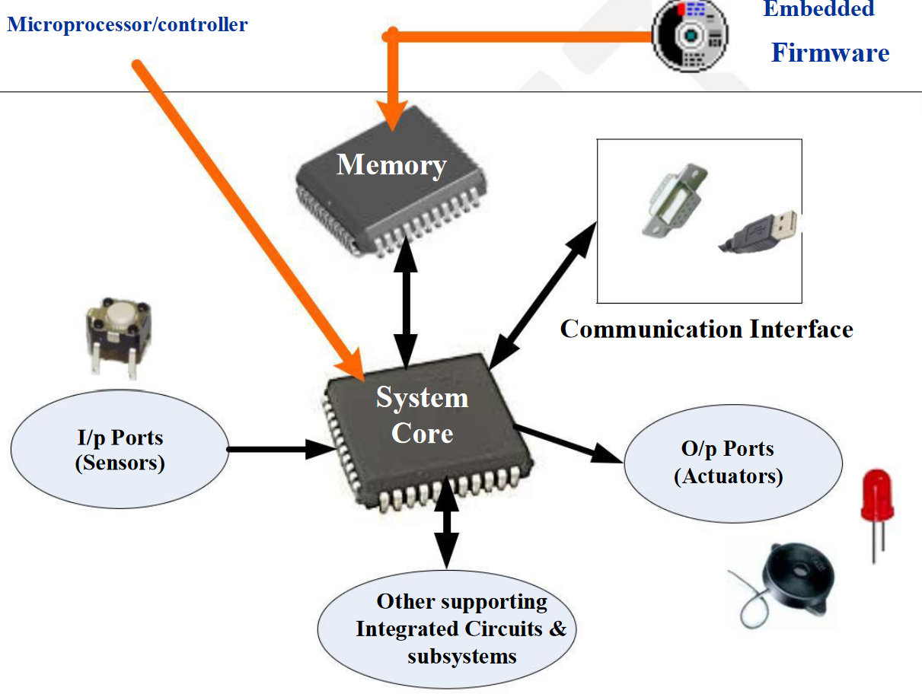
Typical components of an Embedded system

Slide 6
Features of embedded system
Wired / wireless internet connectivity – so that they can be monitored, controlled and updated over the internet.
They have a number of input ports, so that they can be connected to buttons and sensors.
Output ports, so that they can turn on motors, devices or alarms.
The use usually low power devices, meaning they down use a large amount of electricity, especially in standby mode.
Often use input sensors with preset values – these values are used to control when certain actions will happen.

Slide 7
Devices that use embedded system
Consumer Electronics: Camcorders, Cameras etc.
Household Appliances: Television, DVD players, washing machine, Fridge, Microwave Oven etc.
Home Automation and Security Systems: Air conditioners, sprinklers, Intruder detection alarms, Closed Circuit Television Cameras, Fire alarms etc.
Automotive Industry: Anti-lock breaking systems (ABS), Engine Control, Ignition Systems, Automatic Navigation Systems etc.
Telecom: Cellular Telephones, Telephone switches, Handset Multimedia Applications etc.
Computer Peripherals: Printers, Scanners, Fax machines etc.
Computer Networking Systems: Network Routers, Switches, Hubs, Firewalls etc.
Health Care: Different Kinds of Scanners, EEG, ECG Machines etc.
Measurement & Instrumentation: Digital multi meters, Digital CROs, Logic Analyzers PLC systems etc.
Banking & Retail: Automatic Teller Machines (ATM) and Currency counters, Point of Sales (POS)
Card Readers: Barcode, Smart Card Readers, Hand held Devices etc.

Slide 8
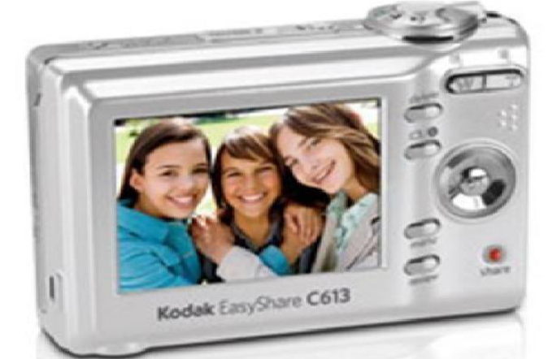
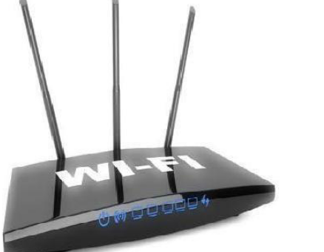
Purpose of Embedded System
Data Collection/Storage/Representation The collected data may be stored directly in the system or may be transmitted to some other systems, or it may be processed by the system or it may be deleted instantly after giving a meaningful representation
Data Communication-are used in applications ranging from complex satellite communication systems to simple home networking system Network hubs, Routers, switches, Modems etc are typical examples for dedicated data transmission embedded systems

Slide 9
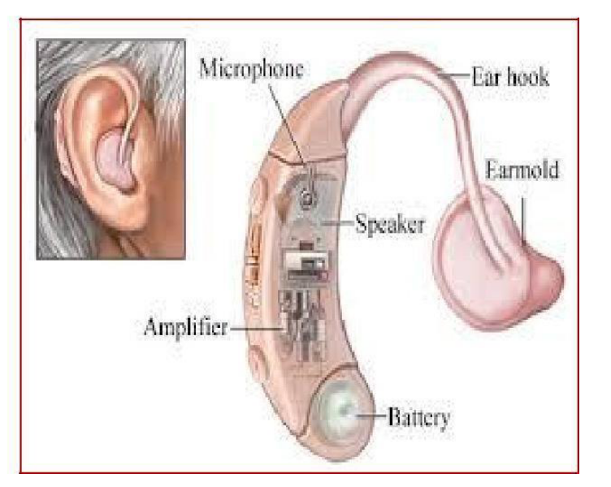
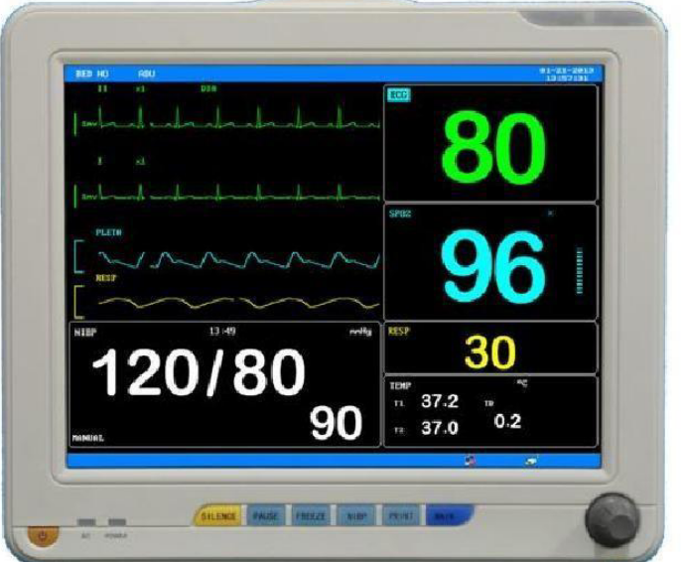
Purpose of Embedded System
Data (Signal) Embedded systems with Signal processing functionalities are used in applications demanding signal processing like Speech coding, synthesis, audio video codec, transmission applications etc
Monitoring: embedded system are used for determining the state of some variables using input sensors

Slide 10
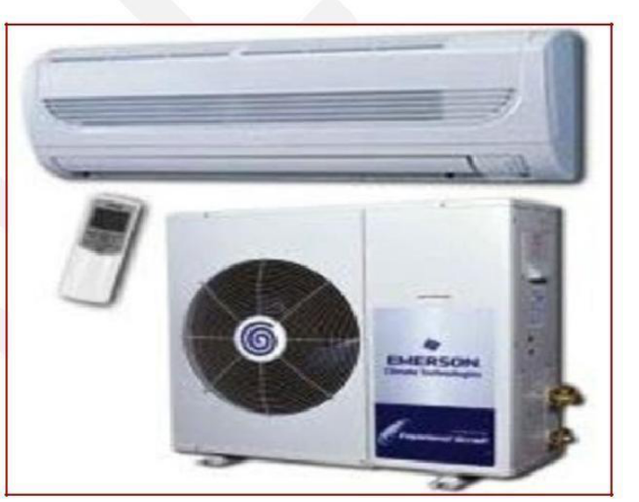
Purpose of Embedded System
Control Embedded systems with control functionalities are used for imposing control over some variables according to the changes in input variables Embedded system with control functionality contains both sensors and actuators
Application Specific User Interface Embedded systems which are designed for a specific application. It contains Application Specific User interface (rather than general standard UI ) like keyboard, display units etc. It is aimed at a specific target group of users such as mobile handsets, control units in industrial applications etc.

Slide 11


Benefits and drawbacks of embedded system
Can't alter, enhance or upgrade.
It is difficult to create a backup of embedded files
It is necessary to reset every setting to avoid any issue with the system.
Troubleshooting is harder
It is more difficult to transfer data across systems to another systems.
Hardware limitations, due to its use for certain tasks
Memory is limited and resources are not sufficient.
To require more development efforts to design an embedded system
Highly efficient at performing tasks
Extremely reliable
Easy to design
Cheap to produce
Compact in size
Low in power consumption

Slide 12
question
Describe how an embedded system controls a washing machine [3]

Slide 13
Question-Solution
Describe how an embedded system controls a washing machine [3]
The user selects the wash cycle they require using a keypad [1]
The microprocessor will process the inputs and begin to heat the water and move the drum to begin the wash. [1]
The actuator controlling the drum and the heating mechanism are the output devices [1]
Sensors will monitor the water level and temperature [1]

